Slide 1
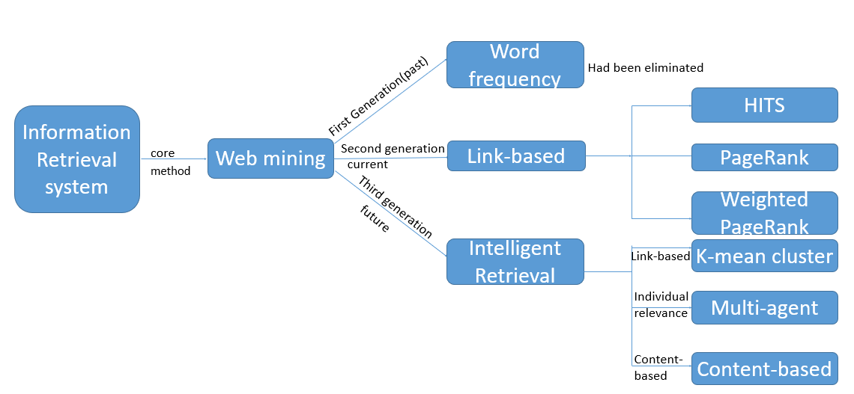
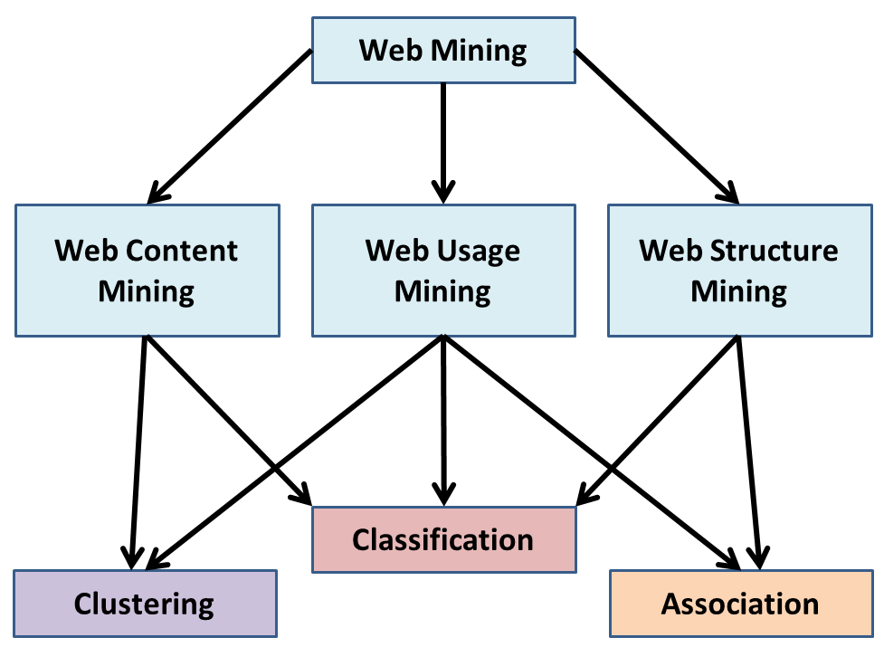
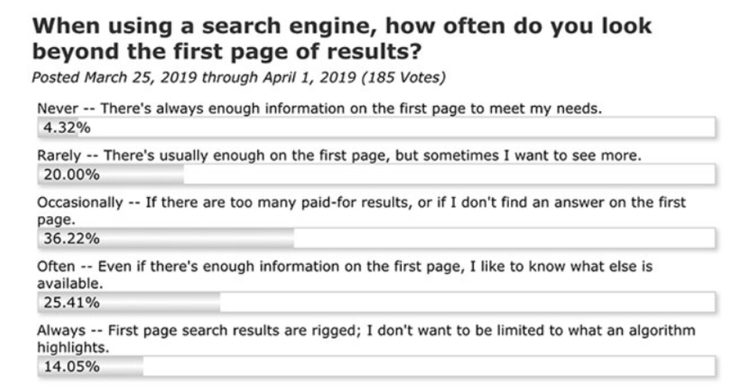
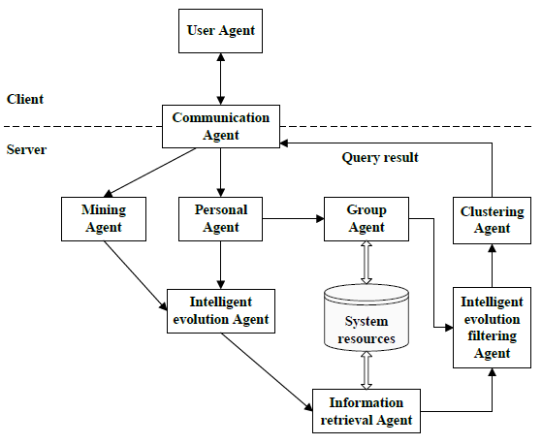
Reference [1] M. Sathya, J. Jayanthi and N. Basker, "Link based K-Means clustering algorithm for information retrieval," 2011 International Conference on Recent Trends in Information Technology (ICRTIT), Chennai, Tamil Nadu, 2011, pp. 1111-1115. [2] N. Duhan, A. K. Sharma and K. K. Bhatia, “Page Ranking Algorithms: A Survey”, 2009 IEEE International Advance Computing Conference, Patiala, 2009, pp. 1530-1537. [3]L. Z. Xiang, "Research and Improvement of PageRank Sort Algorithm Based on Retrieval Results," 2014 7th International Conference on Intelligent Computation Technology and Automation, Changsha, 2014, pp. 468-471. [4] A. Jain, R. Sharma, G. Dixit and V. Tomar, "Page Ranking Algorithms in Web Mining, Limitations of Existing Methods and a New Method for Indexing Web Pages” , 2013, International Conference on Communication Systems and Network Technologies, Gwalior, 2013, pp. 640-645. [5] W. Xing and A. Ghorbani, “Weighted PageRank algorithm”, Proceedings. Second Annual Conference on Communication Networks and Services Research, 2004., Fredericton, NB, Canada, 2004, pp. 305-314. [6] L. Zhang, "An intelligent information retrieval algorithm based on knowledge discovery and self-organizing feature map neural network," 2016 International Conference on Inventive Computation Technologies (ICICT), Coimbatore, 2016, pp. 1-4. [7] L. Yan, Y. Wei, Z. Gui and Y. Chen, "Research on PageRank and Hyperlink-Induced Topic Search in Web Structure Mining," 2011 International Conference on Internet Technology and Applications, Wuhan, 2011, pp. 1-4. [8] Freire, M. M., & Periera, M. (2008). Encyclopedia of Internet technologies and applications. Hershey, PA: IGI Global. [9] Costa, M. D., & Gong, Z. (n.d.). Web structure mining: An introduction. 2005 IEEE International Conference on Information Acquisition. [10] S. G. Pawar and P. Natani, "Effective utilization of page ranking and HITS in significant information retrieval," International Conference for Convergence for Technology-2014, Pune, 2014, pp. 1-6. [11] M. Sathya, J. Jayanthi and N. Basker, "Link based K-Means clustering algorithm for information retrieval," 2011 International Conference on Recent Trends in Information Technology (ICRTIT), Chennai, Tamil Nadu, 2011, pp. 1111-1115. [12] B. Xue and G. Yan, "Research on multi-agents information retrieval system based on intelligent evolution," Proceedings of 2012 2nd International Conference on Computer Science and Network Technology, Changchun, 2012, pp. 1042-1045.
Improving search engine results correlation using intelligent retrieval
基于智能检索提高搜索引擎的结果相关性
지능형 검색을 사용한 검색 엔진의 상관관계 개선
Yufeng Shi | yshi20@masoblive.gmu.edu , Taeuk Kim |tkim46@masonlive.gmu.edu,
Gang Wu | gwu2@masonlive.gmu.edu
Department of George Mason university, Volgenau School of Engineering
Introduction
Due to the rapid accumulation of the information on the web, users are suffering from finding accurate and relevant information. Therefore, there were several web structure mining techniques and algorithms developed to overcome this problem. Nowadays, people mainly rely on information retrieval systems to obtain information. However, users still encounter a lot of obstacles in the searching process [1]. If users use keywords in searching process, they will get a large set of retrieval results, and few information can be valuable for them [2]. More important, it is waste of time for users to filter out irrelevant information from retrieval results [3]. To solve the problem, we need to present a new model of the information retrieval system.
Jain et. Al [4] refer two main problems of current information retrieval systems:
There are millions of data and search results, it is unable to visit all these massive web pages to find the required information.
If few initial links shown in the search results, we may not get the relevant information.
Jain et. al pointed out existing algorithms don’t apply “Intelligent search factor”, said the search results need to contain interpreting the inherent meaning of the query and indexing. Thus, the upcoming search engine’s aiming is to combine the personal relevance and content feature with link-based algorithm to optimize the search engine.
Intelligent retrieval
We introduce a new term called “Intelligent retrieval” to achieve this goal. Intelligent retrieval can solve the semantic understanding and user feedback to return the more precise retrieval results [5]. Also, this technology will give a huge improvement on increasing efficiency on search result and compressing calculating time as much as possible [6].
Intelligent Retrieval
Intelligent retrieval, a new generation of information retrieval system [3]. The most obvious difference of it with the current information system (link-based) is it can provide individual services to simplify the retrieval results [10]. At the same time, with entering user’s query demand, semantic understanding and user feedback are calculated by this system so that it can adjust and update itself to meet more precise user’s individual requirement [11]. Thus, this is why it is named intelligent retrieval.
K-Means clustering algorithm can make the results more relevant and decrease the response time when search engine retrieves the results. K-Means clustering designs a brief algorithm to achieve the division on n observations into k clusters and then to find which cluster is closest to mean value [11].
The multi-agent is a search system which can analyze the users’ potential interest by storing the past user’s query history and visiting record on website [12]. In this way, to retrieval more relevant information for individual. Not only this, with the long time users use this algorithm, the system will continue to correct and judge itself about the preference based on the changing from search information by users. This is why it is called intelligence.
Contend-based ranking technology, a new retrieval way which consider the context of the websites’ text frequencies and similarity for ranking the page.
Figure 1. the relationship between different concepts
Discussion
By applying link-based and individual relevance technologies, it will be some improvements on increasing efficiency on search result and compressing calculating time as much as possible. However, the true intelligent retrieval is combing the link-based, intelligent retrieval and content-based features, which gives the future researchers the directions that they should do a lot of efforts on achieving content-based technology. In this way, the information retrieval will never bother users to spend much time to find the most relevant answers about their queries.
For the future, the researchers should consider more factors about intelligent retrieval like content-based algorithm and self-organizing feature map neural network technology. Also, the future work will add new parameter in searching algorithm using web usage mining to improve the search result this include data as server access logs, referrer logs, client-side cookies, user profile and meta data which retrieved from user’s surfing pattern.
figure 1. The survey about how people feel about current search engine
Web Mining
In general, Web mining can be classified into three categories Web content mining, Web structure mining and Web usage mining.
Web usage mining focuses on techniques that could predict the behavior of users while they are interacting with the WWW [9]. Web usage mining collects the data from Weblog records to discover user access patterns of Web pages.
Web content mining targets the knowledge discovery, in which the main objects are the traditional collections of text documents and the collections of multimedia documents such as images, videos, audios, which are embedded in or linked to the Web pages [9].
Web structure mining is also called link mining. It is mainly used in the field of information retrieval on the WWW and based on the topology of the hyperlink which can be used to improve the quality of search engine queries [8]. In general, the search engine query results are usually relatively large, the content is a lot of irrelevant information query, it can analyze and classify the similarities and relationships of hyperlinks on different websites to rank search results. [7]. For example, PageRank and Hits are the popular web structure mining algorithms.
Figure 2. the structure of web mining
Figure 3. multi-agent work[4]

