Slide 1
Academic Integrity for International students
Taeuk Kim
Satya Sai Jayanth

Slide 2
What is this graph for?

Slide 3
Why aiv occurs?
Cultural influences can help students to cheat
Different concept of cheating
Annual rising of international student in USA
=> Academic misconduct incident rise

Slide 4
Western style of citing sources
Not the common citation rule in the world
Especially Asian students
Repeating textbook and professor’s word is sign of respect to the source of knowledge

Slide 5
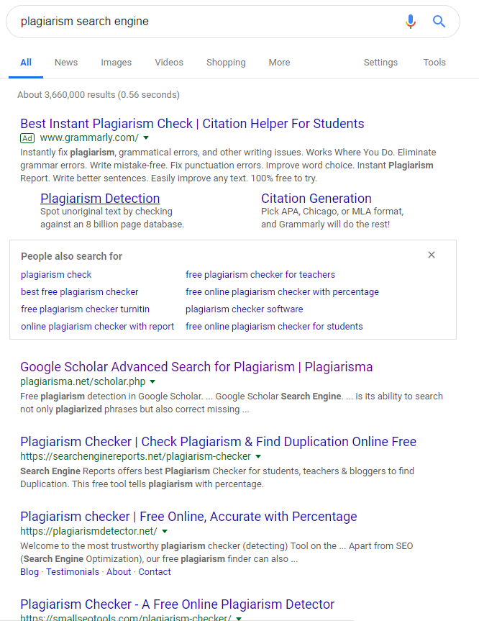
Asian(ex. ROK)
Based on words, sentences similarity
No plagiarism search engine
USA
Based on context, content, main point similarity
Plenty of plagiarism search engine exists

Slide 6
Language barriers
International student influenced by different teaching and learning styles
Do not make contact to faculty or other academic resources
Feel isolated
Students struggles to get high grade => Pressure

Slide 7
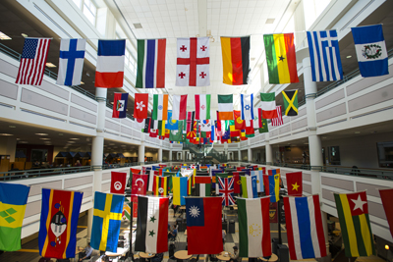
resolutions
Orientation
Send messages to international students
Point differences between their country throughout their college career.
Recruit international students
Support other international students who have questions
Student responsibility
Most important thing

Slide 8
Honor Code Statement
To promote a stronger sense of mutual responsibility, respect, trust, and fairness among all members of the George Mason University Community and with the desire for greater academic and personal achievement, the student members of the university community, have set this Honor Code.
Student Members of the George Mason University community pledge not to cheat, plagiarize, steal, or lie in matters related to academic work.

Slide 9
Cheating
Duplicate use of other student’s work.
Submission of another individual’s work.
Violation of course requirements regarding integrity.
Providing or attempting to benefit from unauthorized academic material.

Slide 10
Plagiarism
Self-plagiarism.
False citation.
Inadequate citation.
Failure to quote sources or material

Slide 11
Stealing
Taking photos of exams/academic work without authorization or permission.
Taking others work without their knowledge.
Removing an exam or other academic work from a classroom without authorization.

Slide 12
Lying
Falsifying sources, data or information.
Providing false information, including identifying information.
Falsifying official correspondence.
Providing a false excuse for missing a class or test.

Slide 13
The Process and Resolution Options
Students have three resolution options:
a prehearing resolution.
a full case review.
sanctions only case review.

Slide 14
Prehearing Resolution
During the prehearing meeting,student is presented with all information submitted by the referring party.
At the hearing, the student may choose to accept responsibility and the faculty recommended sanction.

Slide 15
Full Case Review.
In Person Hearing:
The incident reported is only supported by eyewitness testimony.
The student is facing suspension or permanent dismissal from Mason.
Expedited Review:
An expedited review is a resolution option where neither the student nor the faculty member appear in person before the Honor Committee

Slide 16
Sanctions Only Case Review
The professor agrees to an amended grade related sanction.
The referred student demonstrates that extenuating circumstances exist that would justify the sanction being amended.

Slide 17
Record Keeping and Reporting
An honor code referral is part of a student’s educational records are protected by FERPA.
whose case is dismissed prior to resolution can be assured that no record is maintained OAI office.

Slide 18
Conclusion
As a George Mason Student, we should follow the rule of Mason’s Honor Code.
Especially, we are international student, could be easily violate academic integrity in order to cultural reason, whether it is intended, or unintended.
Check the Mason Honor Code, and ask for assistance.

Slide 19
references
[1] Fass - Holmes, Barry ; Journal of International Students, 2017, Vol.7(3), p.664-669 (https://search.proquest.com/docview/1902047847?OpenUrlRefId=info:xri/sid:primo&accountid=14541)
[2] Elizabeth Redden ; Cheating Across Cultures, Inside Higher Ed (https://www.insidehighered.com/news/2007/05/24/cheating-across-cultures)
[3] Korea without plagiarism criteria or search system ; Newspaper
(http://news.chosun.com/site/data/html_dir/2013/03/23/2013032300175.html)
[4] Office of Academic Integrity(https://oai.gmu.edu/)
[5] George Mason University Honor Code 2018-2019 Final

