Slide 1
Trade Journal review -Machine Learning 101

Slide 2
Concept of machine learning
Machine Learning is the part of Artificial Intelligence(AI) and System Control.
Machines can learn, rather than be programmed.
It uses data and statistical techniques to provide insight.
Machine learning uses past experiences as data.
Main value of machine learning
- Receiving actionable insight to make better decisions than before.

Slide 3
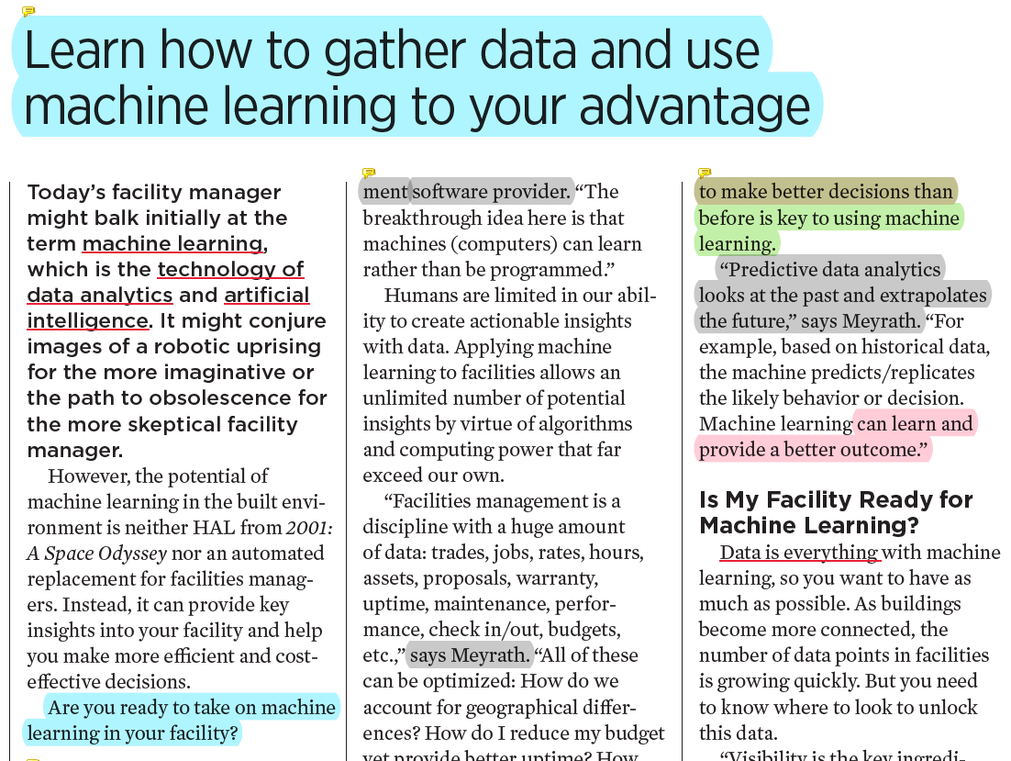
Who is the main target of this article?
-> Facility Manager
What is the author’s object?
-> Make audiences to learn how to gather data and how to use machine learning.
Why I chose this article?
-> They suggest fundamental factors who want to apply machine learning.

Slide 4
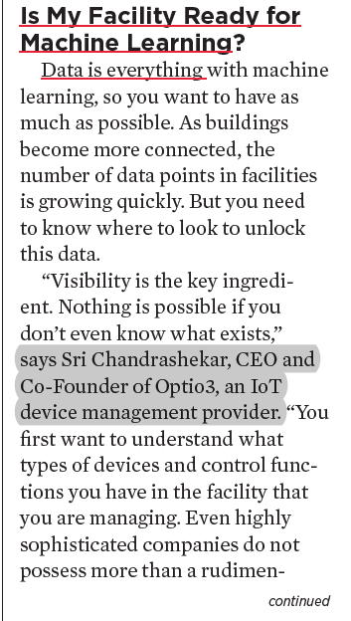
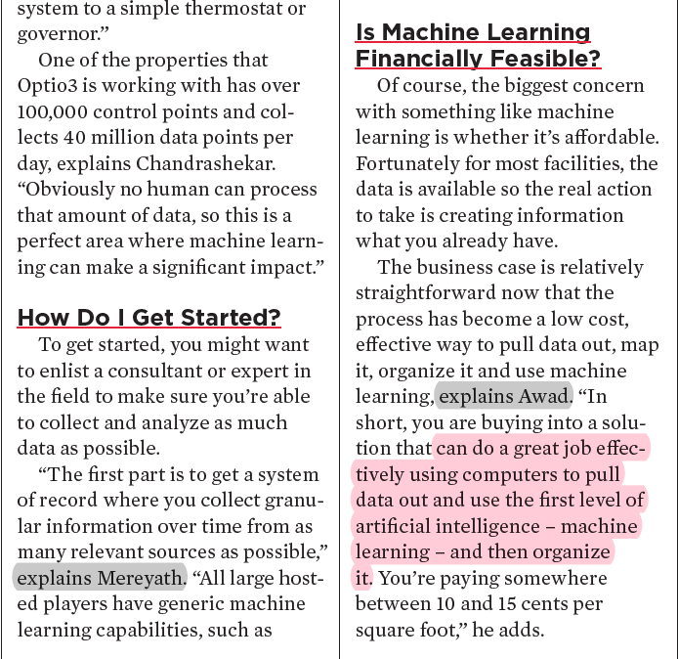
Suggest three main questions who want to use machine learning.
Explain concepts and show examples by using expert’s comments.
Quote three experts’ comment.
(Hugues Meyrath, Sri Chandrashekar,
Ash Awad)

Slide 5
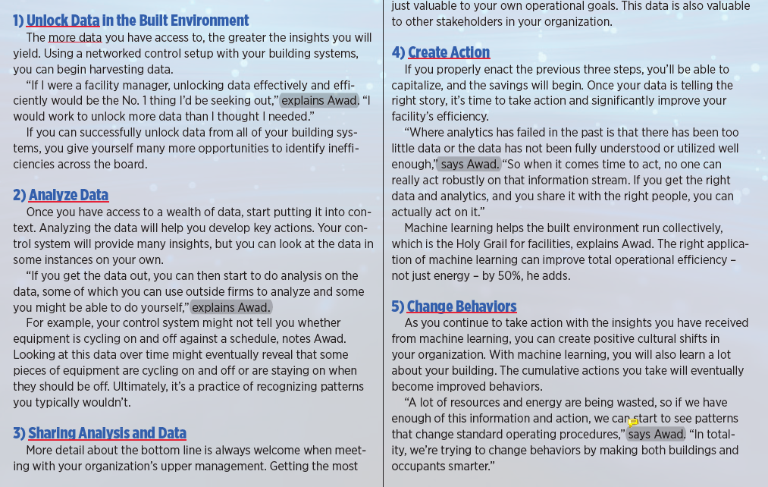
Main output : 5 Steps to optimize facility with data analytics
= 5 Blueprints for machine learning
1) Unlock data in the built environment
2) Analyze data
3) Sharing analysis and data
4) Create action
5) Change behaviors

Slide 6
Current Problems and Expectations
Humans are limited in our ability to create actionable insights with data.
-> Machine learning allows an unlimited number of potential insights by virtue of algorithms and computing power that far exceed our own.
Machine learning will get applied to more use cases – going from more generic to specific problems, verticals, trades, etc.
Learning gets accelerated over time, and thereby machine learning yields more and more insights.

Slide 7
What is this trade journal expected to do?
The author tries to explain machine learning to facility managers by this article.
The article shows basic steps of applying machine learning.
This article can give interest to people and help people who want to do project about Machine learning or AI .

